Slide 1

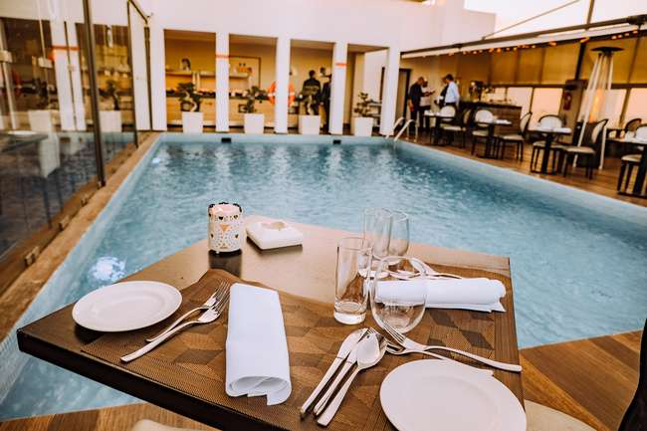
HOTEL RESERVATIONS ANALYSIS
SQL ANALYSIS
KOLAPO MAYOWA
MIP-DA-10

Slide 2


TABLE OF CONTENT
01 Introduction
02 Problem Statement
03 Dataset Overview
04 Dataset Explanation
05 Dataset Exploration using SQL

Slide 3
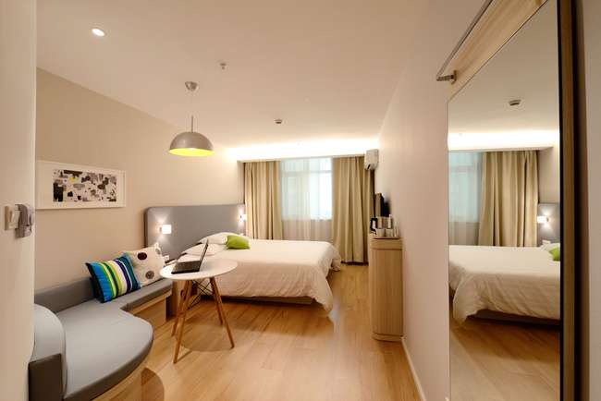
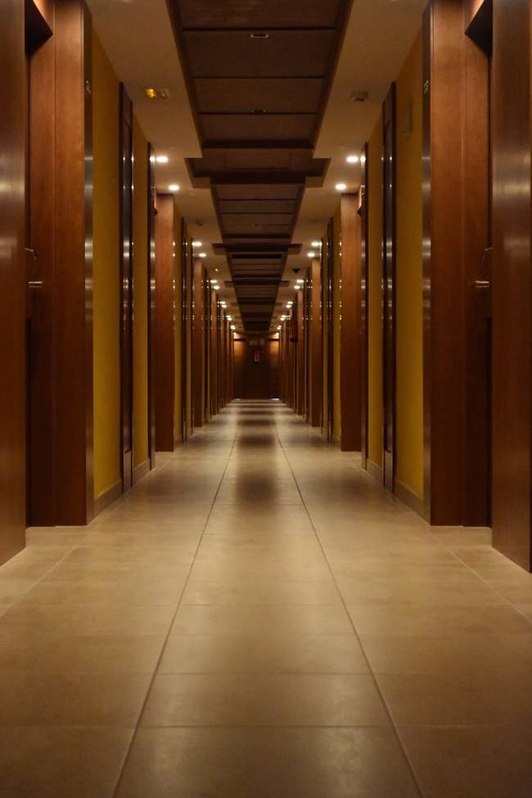

INTRODUCTION
OBJECTIVE
To analyze hotel reservation data to gain insights into guest preferences and booking trends,
IMPORTANCE
Data-driven decisions can optimize hotel operations and enhance guest satisfaction.
GOALS
To analyze hotel reservation data to gain insights into guest preferences and booking trends

Slide 4




PROBLEM STATEMENT
CHALLENGES IN HOTEL RESERVATION MANAGEMENT
OBJECTIVES
Optimizing Room Allocation: Understanding booking patterns to maximize room occupancy.
Enhance Guest Satisfaction: Personalizing services based on guest preferences.
Revenue Management: Strategically pricing rooms to maximize revenue.
Insight Generation: Uncovering actionable insights from reservation data.
Decision Support: Providing data-driven recommendations for effective hotel management.
SIGNIFICANCE
Operational Efficiency: Streamlining processes to reduce costs and enhance service delivery.
Competitive Advantage: Differentiation offerings to attract and retain guests.
Guest Retention: Enhancing guest satisfaction and loyalty through personalized experiences.

Slide 5


DATASET OVERVIEW
Overview
Purpose: The hotel industry relies on data for informed decisions and guest experience enhancement.
Dataset: Hotel reservation dataset used to gain insights into guest preferences and booking trends.
Columns: 12 columns capturing various reservation details.
Rows: Contains 700 rows of data for analysis.
Key Columns
Booking_ID,no_of_adults,no_of_children,no_of_weekend_nights, etc
Goals
Insight: Understand guest preferences and optimize hotel operations.
Analysis: Utilize SQL for querying and analyzing data to answer specific questions.

Slide 6
DATASET EXPLANATION
booking_ID: A unique identifier for each hotel reservation.
no_of_adults: The number of adults in the reservation.
no_of_children: The number of children in the reservation.
no_of_weekend_nights: The number of nights in the reservation that fall on weekends.
no_of_week_nights: The number of nights in the reservation that fall on weekdays.
type_of_meal_plan: The meal plan chosen by the guests.
room_type_reserved: Type of room reserved.
lead_time: Days between booking and arrvial.
arrival_date: Date of arrival.
avg_price_per_room: Average price per room in the reservation.
booking_status: Status of the booking (confirmed, cancelled)

Slide 7
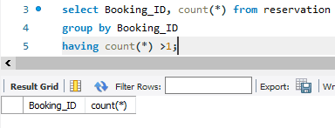

DATA EXPLORATION USING MYSQL
CODE TO CHECK FOR DUPLICATE VALUES
RESULT
NO DUPLICATE VALUES
CODE TO FORMAT THE DATE COLUMN

Slide 8
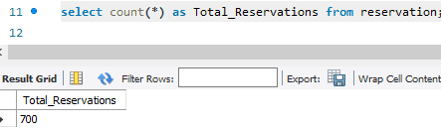
DATA EXPLORATION USING MYSQL
WHAT IS THE TOTAL NUMBER OF RESERVATIONS IN THE DATASET?
RESULT
700 RESERVATIONS

Slide 9
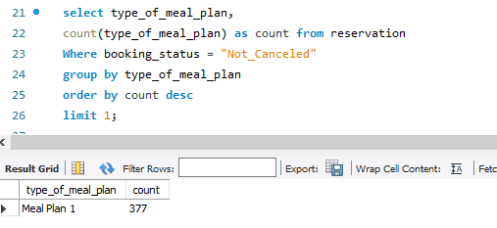
DATA EXPLORATION USING MYSQL
2. WHICH MEAL PLAN IS THE MOST POPULAR AMONG GUESTS?
RESULT
MEAL PLAN 1

Slide 10
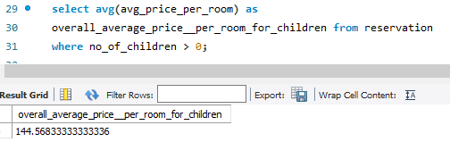
DATA EXPLORATION USING MYSQL
3. WHAT IS THE AVERAGE PRICE PER ROOM FOR RESERVATIONS INVOLVING CHILDREN?
RESULT
144.56833 APRROXIMATELY

Slide 11
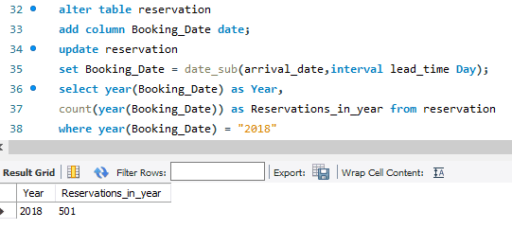
DATA EXPLORATION USING MYSQL
4. HOW MANY RESERVATIONS WERE MADE FOR THE YEAR 20XX (REPLACE XX WITH THE DESIRED YEAR)?
RESULT
IN 2018, 501 RESERVATIONS WERE MADE

Slide 12
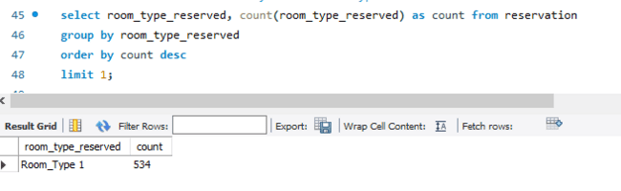

DATA EXPLORATION USING MYSQL
5. WHAT IS THE MOST COMMONLY BOOKED ROOM TYPE?
RESULT
ROOM_TYPE ! WITH 534 ROOMS BOOKED

Slide 13
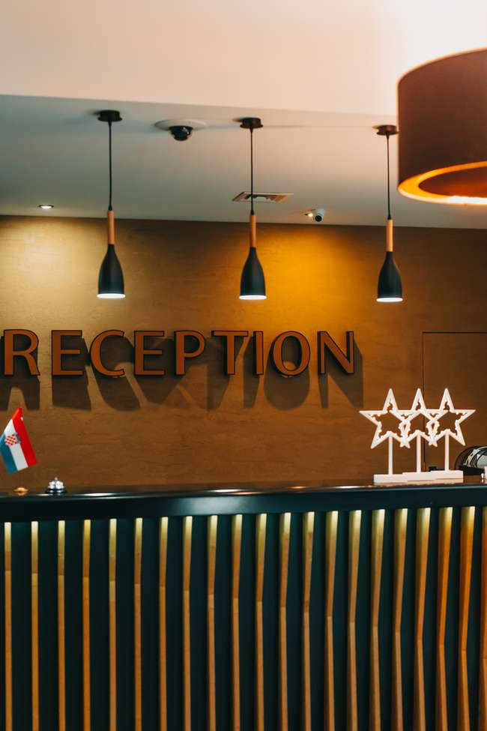
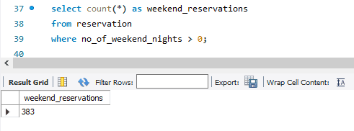
DATA EXPLORATION USING MYSQL
6. HOW MANY RESERVATIONS FALL ON A WEEKEND (NO_OF_WEEKEND_NIGHTS > 0)?
RESULT
383 RESERVATIONS

Slide 14
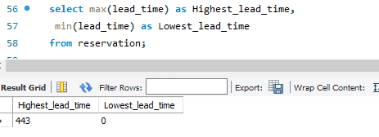
DATA EXPLORATION USING MYSQL
7. WHAT IS THE HIGHEST AND LOWEST LEAD TIME FOR RESERVATIONS?
RESULT
THE HIGHEST AND LOWEST LEAD TIME IS 443 AND 0 RESPECTIVELY

Slide 15
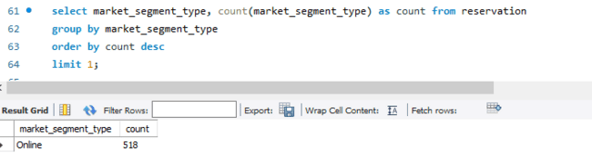
DATA EXPLORATION USING MYSQL
8. WHAT IS THE MOST COMMON MARKET SEGMENT TYPE FOR RESERVATIONS?
RESULT
ONLINE

Slide 16
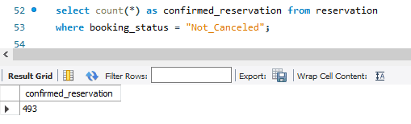
DATA EXPLORATION USING MYSQL
9. HOW MANY RESERVATIONS HAVE A BOOKING STATUS OF "CONFIRMED"?
RESULT
493 RESERVATIONS

Slide 17
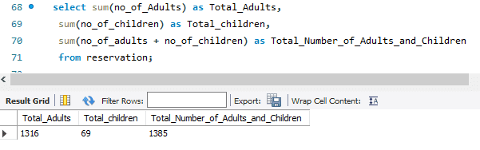

DATA EXPLORATION USING MYSQL
10. WHAT IS THE TOTAL NUMBER OF ADULTS AND CHILDREN ACROSS ALL RESERVATIONS?
RESULT
THERE ARE 69 CHILDREN AND 1316 ADULTS ACROSS ALL RESERVATIONSTIONS

Slide 18
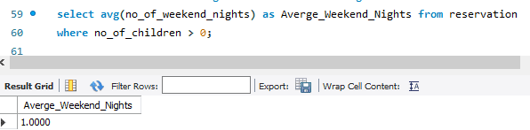

DATA EXPLORATION USING MYSQL
11. WHAT IS THE AVERAGE NUMBER OF WEEKEND NIGHTS FOR RESERVATIONS INVOLVING CHILDREN?
RESULT
1.0000

Slide 19
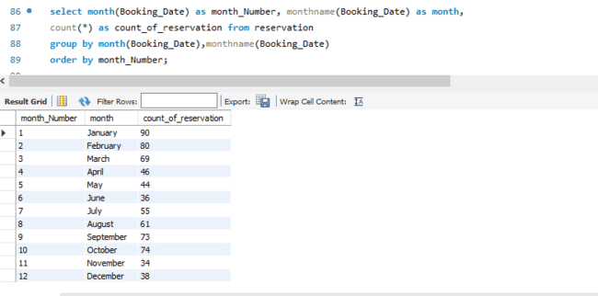
DATA EXPLORATION USING MYSQL
12. HOW MANY RESERVATIONS WERE MADE IN EACH MONTH OF THE YEAR?

Slide 20
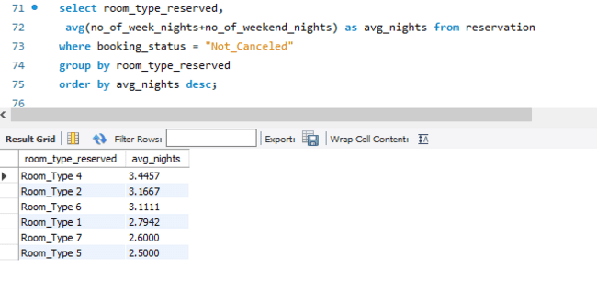
DATA EXPLORATION USING MYSQL
13. WHAT IS THE AVERAGE NUMBER OF NIGHTS (BOTH WEEKEND AND WEEKDAY) SPENT BY GUESTS FOR EACH ROOM TYPE?

Slide 21

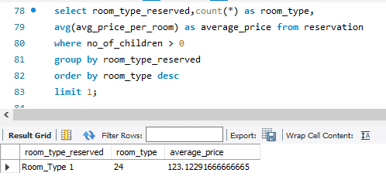
DATA EXPLORATION USING MYSQL
14. FOR RESERVATIONS INVOLVING CHILDREN, WHAT IS THE MOST COMMON ROOM TYPE, AND WHAT IS THE AVERAGE PRICE FOR THAT ROOM TYPE?
RESULT
ROOM_TYPE_1 WITH AVERAGE PRICE OF 123.12 APPROX

Slide 22
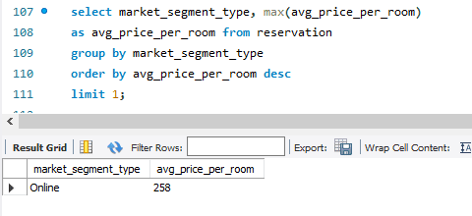
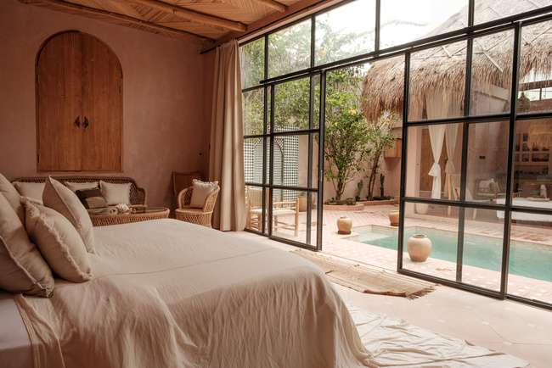
DATA EXPLORATION USING MYSQL
15. FIND THE MARKET SEGMENT TYPE THAT GENERATES THE HIGHEST AVERAGE PRICE PER ROOM.
RESULT
ONLINE WITH 258 AVG_PRICE_PER_ROOM

Slide 23

OVERALL INSIGHT
There are 700 reservations in the dataset.
Meal plan 1 stands out as the most popular choice among guest.
Reservation involving children have an average room price of 145 approximately.
In 2018, there were 501 reservations.
Room type 1 is the preferred choice for bookings with 534 bookings.
383 reservations fall on the weekend.
The most common market segment type is online, with 518 reservations.
493 out of 700 reservations are confirmed, indicting a 70.43% success rate.
Majority of reservation 1,316 involve adult guests.
Reservations with children suggest a preference for averagely one-night stay on weekends.
The peak reservation month is October, while January records the lowest number of reservation.
Room type 4 guests prefer longer night stays (average of 3.45 nights), while Room type 5 guests opt for shorter durations.
For reservations involving children Room type 1 is the preferred choice with an average room price of 123.12.
Online bookings generated the highest average price per room reaching approximately 258.

Slide 24
THANK YOU

